Slide 1


BIDDS Debrief Card
UNCLASSIFIED
V1.1
UNCLASSIFIED

Slide 2
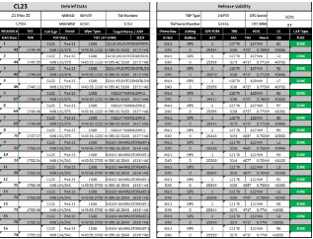
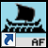
Objective
Generate B-52 weapon release data from DTC flight data recorder files for post-flight debrief and Shot Vals.
Requirements- BIDDS v4.1, ODD-EC Manager, ODD-EC DTC sled, Debrief Program
Install Guide provided at end of guide

Slide 3
Workflow
The DTC logs mission data automatically during flight
BIDDS allows you to view this mission data and save to a text file
BIDDS Debrief Card searches this text file for all release data, reformats data, and outputs to an Excel Spreadsheet
DTC
FLD File (BIDDS)
TXT File (BIDDS)
Debrief Card (Debrief)

Slide 4
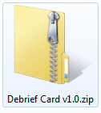
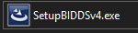
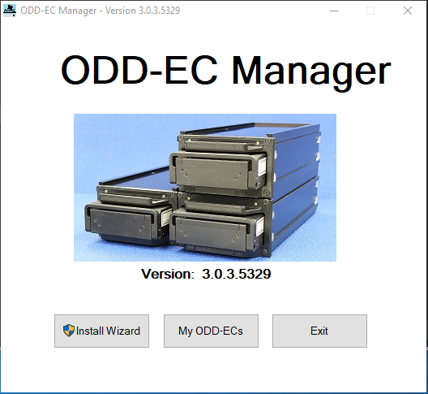
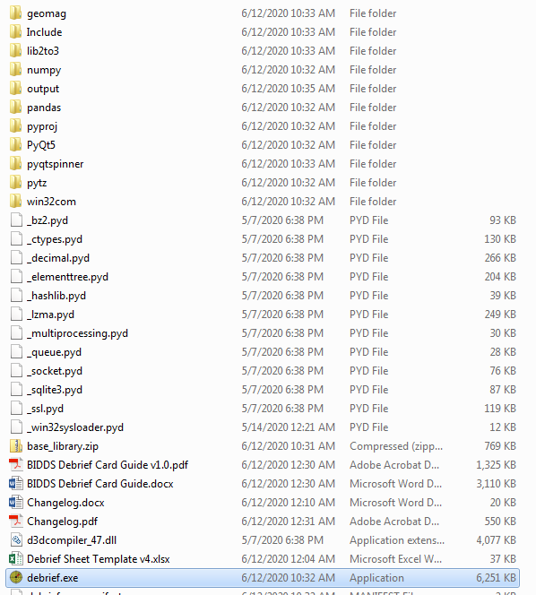
Install
Unzip Debrief Card.zip to Desktop or Network Share
Create a shortcut to debrief.exe for quick access
Install BIDDS v4 and ODD-EC using SetupBIDDSv4.exe
Once ODD-EC Manager installed, click Install Wizard to find DTC sleds

Slide 5
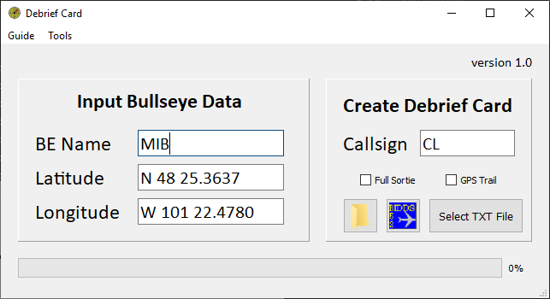
Step 1: Debrief Program Open/Type Data
Open Debrief Program (debrief.exe)
Input Sortie Data
Input Bullseye Data from Sortie.
This will be used to calculate Target/Release bullcuts on the final card.
Format needs to be H DD MM.MMMM
Input Callsign (base callsign will be saved for future cards)
By Default, the program searches the Flight Recording text file only for mission data at release time. This significantly speeds up creating the card. If you would like to output mission data for the entire sortie, select Full Sortie (i.e. you would like a GPS file with the entire route). Expect parsing to take approx. 5 minutes versus 1 minute for defaults.
Check GPS file, if you would like a JMPS GPS file to be created.

Slide 6
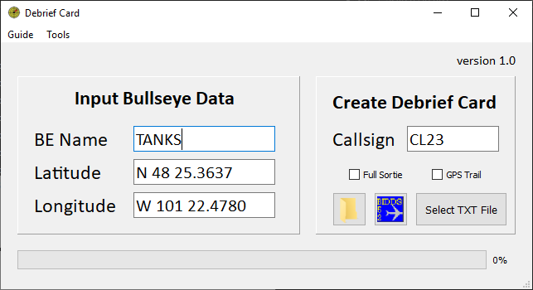
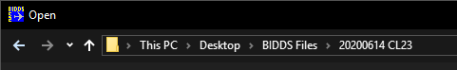
Step 2: Debrief Program Create Folder
Click on Folder Icon
A new folder will be created on your desktop if it doesn’t exist already
Desktop/BIDDS Files/YYYYMMDD CS
Folder will open
This folder will be where you save your files required to create your Debrief Card

Slide 7
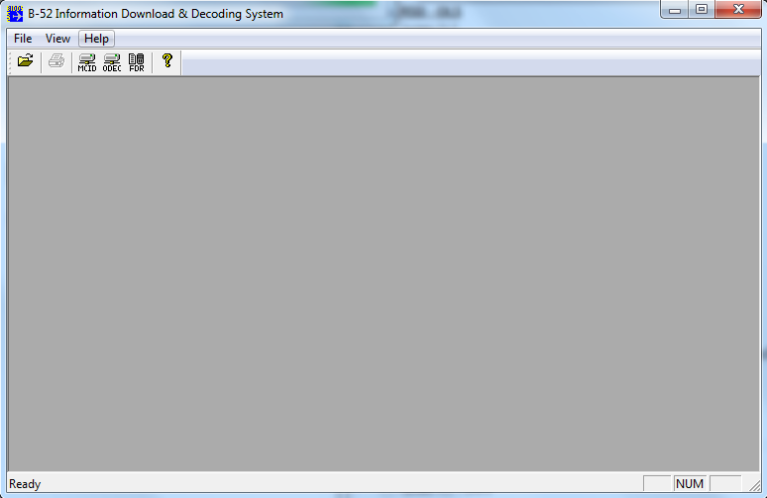
Step 3: BIDDS Open
Click on BIDDS Icon, BIDDS will open

Slide 8
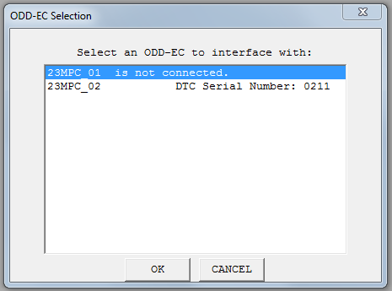
Step 3: BIDDS Select DTC
Insert DTC into ODEC
Click ODEC and select DTC

Slide 9
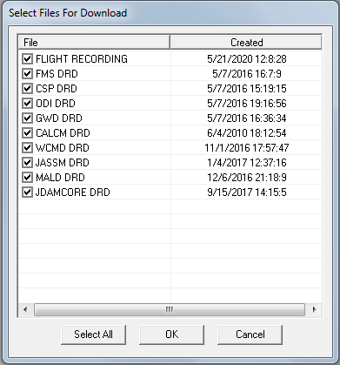
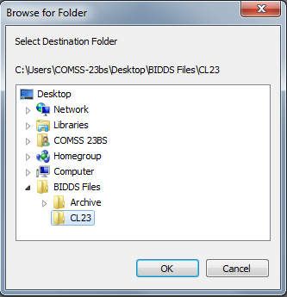
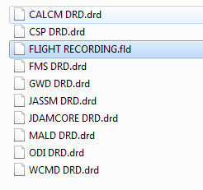
Step 2: BIDDS Save FDR Files
Select all files and save to Debrief Folder
20200614 CL23

Slide 10
Step 2: BIDDS Copy DRD Files (as required)
The DTC saves flight data into the FLIGHT RECORDING.fld file.
The DRD files are used to decode this FLD file and need to be in the BIDDS program folder located at C:\Program Files (x86)\BIDDS.
After initially installing BIDDS and after OLS updates, copy the current DTC DRD files to this folder or you will get an error
Error: A DRD file could not be found that matches the application ID
A shortcut to this folder is provided in the Debrief Card Toolbar: Tools>Open BIDDS Folder
Once the DRD files are copied to the BIDDS folder, you don’t need to copy again unless a different OLS DTC is used

Slide 11
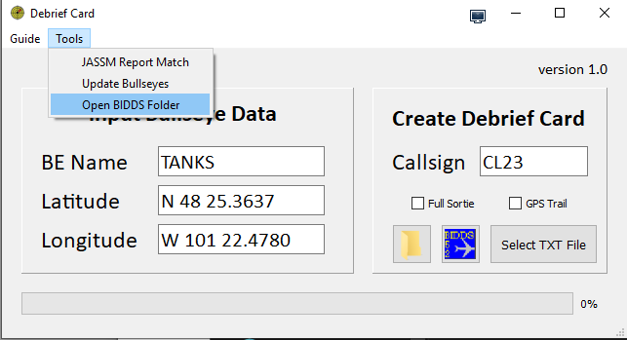
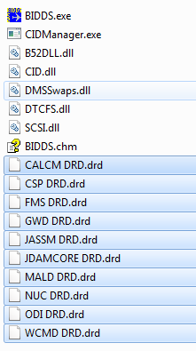
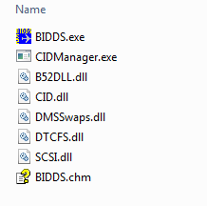
Step 2: BIDDS Copy DRD Files (as required)
Example Saving DRD files into BIDDS Install Folder
Copy DRD files saved from DTC into BIDDS Installation folder prior to opening FDR files in BIDDS
New BIDDS Install (no DRD files)
C:\Program Files (x86)\BIDDS

Slide 12
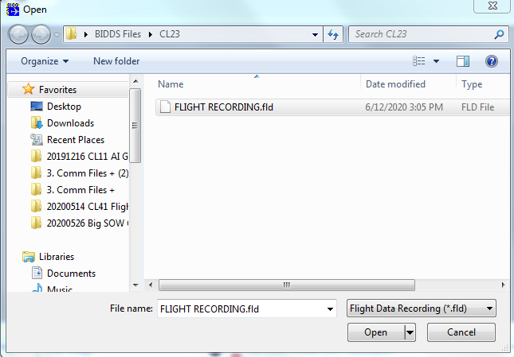
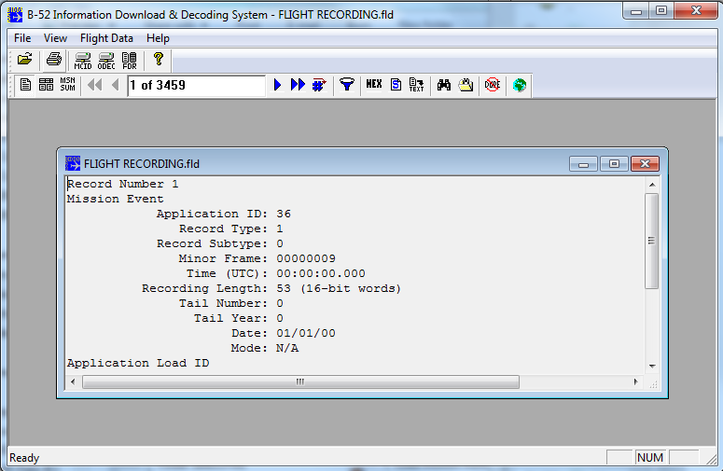
Step 3: BIDDS Open FLD File
Click open in BIDDS and select previously saved FDR file saved from DTC (Desktop/BIDDS Files/)

Slide 13
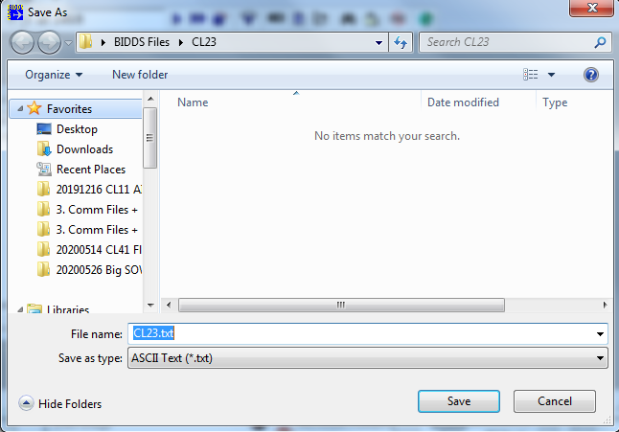
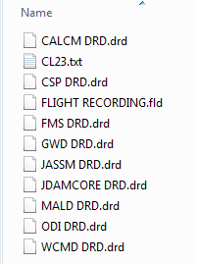
Step 3: BIDDS Save FLD to Text File
Click on Text Save in Toolbar
Text file saved in Debrief Folder. This file contains all the Flight Recording files in text format
Note: BIDDS will freeze up while saving this file. Do not continue to next step until BIDDS is no longer frozen (spinning wheel). The text file may take up to 5 min to create if the Flight Recording has not been erased prior to flight since all flights continue writing to the same file
Save as Callsign.txt

Slide 14
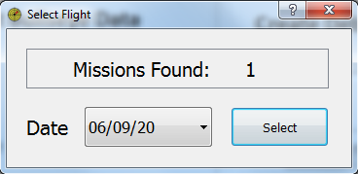
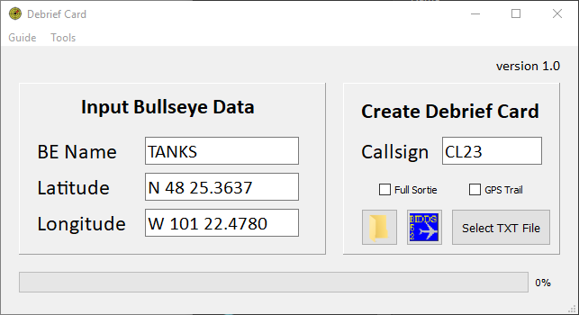
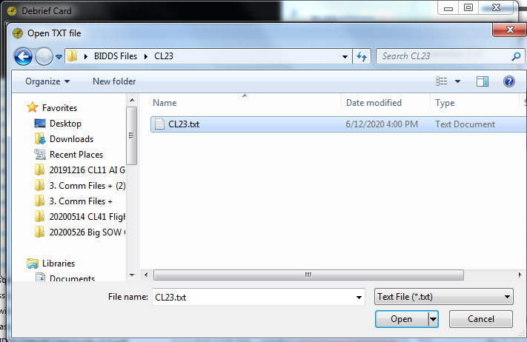
Step 4: Debrief Program Select Text File
Open Debrief Program (debrief.exe)
Select the date you Mission Flew
Click Select TXT File
Find TXT file saved from BIDDS

Slide 15
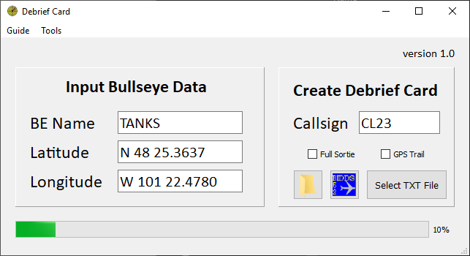
Step 4: Debrief Program Loading
The program will start searching the file and update progress bar
The program will now search the text file. In the background, 3 different record types are searched then matched.
Mission Events- Records showing aircraft parameters
Weapon Release Events- Different for each weapon
SOW IZ LAR Records- For TOF calculations
These events are then matched combined to output all the required data for a release. Realize there are some limitation inherent to how the DTC logs missions:
Some data that is matched between events may have a time difference of up to 10 seconds
Some data is missing/needs to be filled in later
GPS FOM only logged for GWD release, defaults to 1 for other releases
JASSM JDPI data needs to be paired to a JASSM DTC Summary

Slide 16
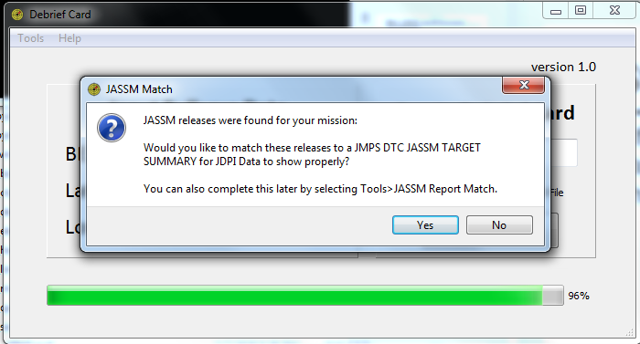
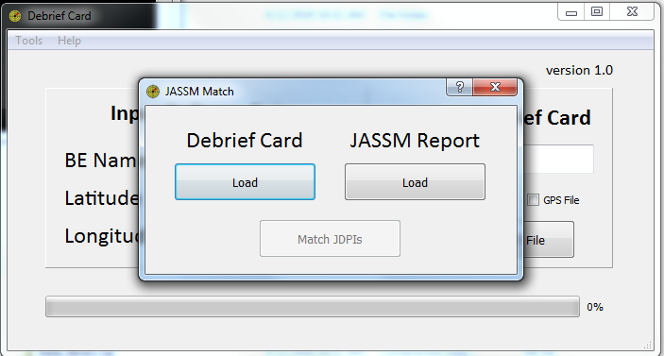
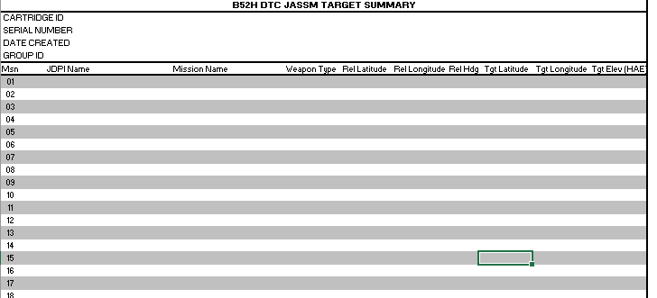
Step 4: Debrief Program JASSM match
If JASSM releases are found, a dialog will ask if you would like to match to a JASSM DTC Summary Report. Select Report to have JDPI name, coordinates, elevation be displayed properly. This can also be accomplished after.
Tools>JASSM Report Match
or

Slide 17
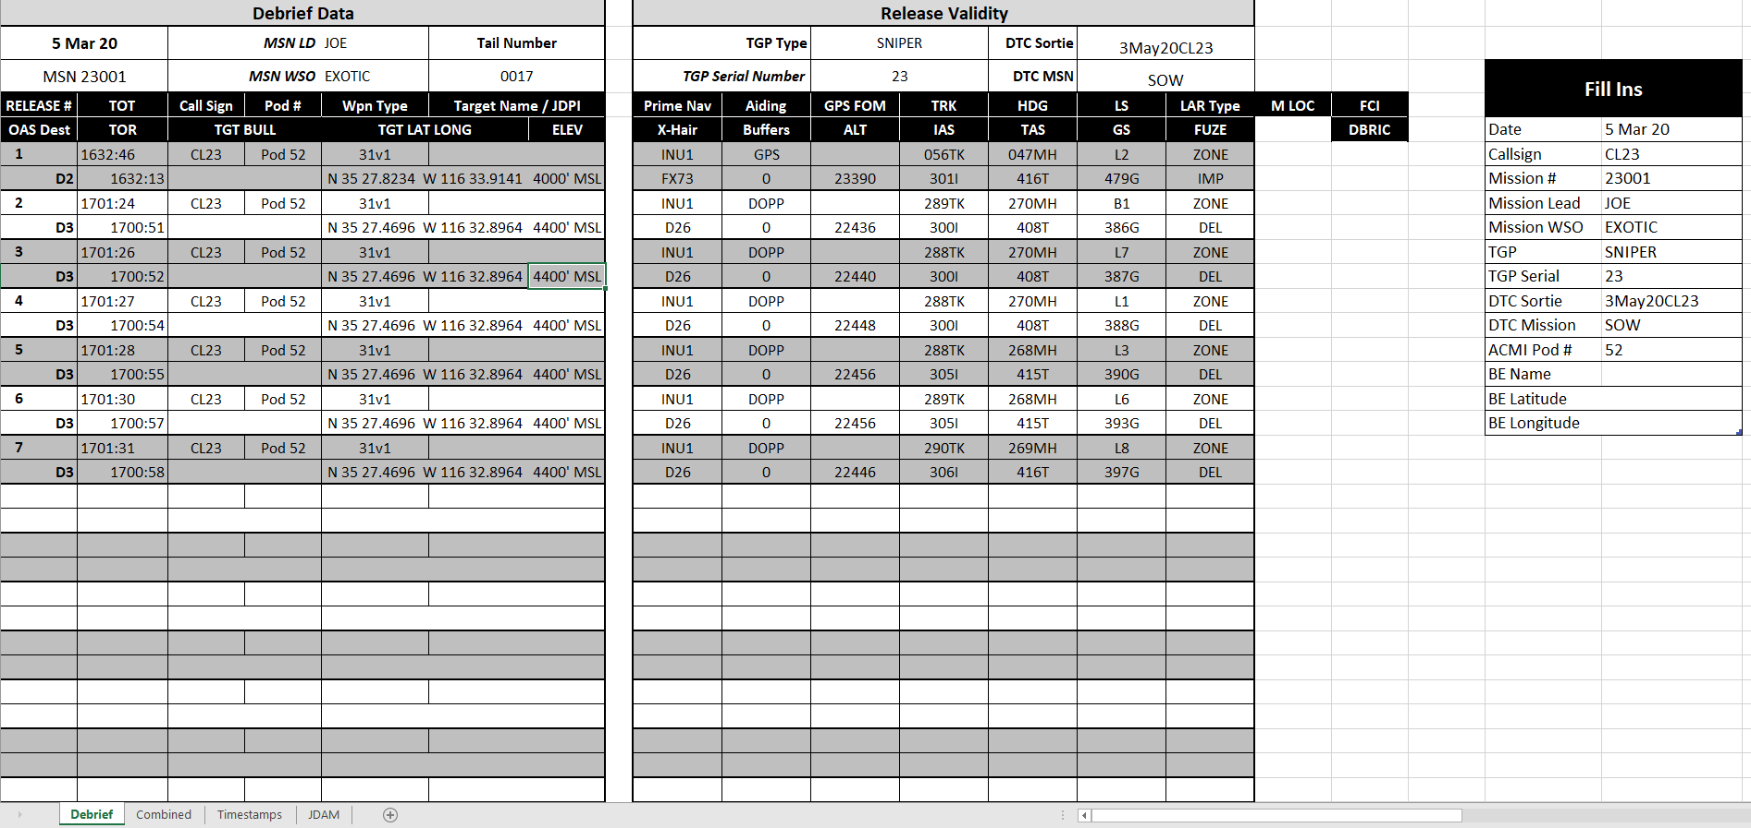
Step 4: Debrief Program Excel
Once complete, the Debrief Card will open automatically
Update the Fill Ins fields on the right of the card to populate the remaining data in the card.
Other Sheets:
Combined (This is where all the debrief data pulls from). Fill in missing/incorrect release data on this sheet and it will be pulled into the Debrief Card automatically
Timestamps (Shows all Mission Events from FDR File)
Weapon Tabs
Show release events and all data from FDR File

Slide 18
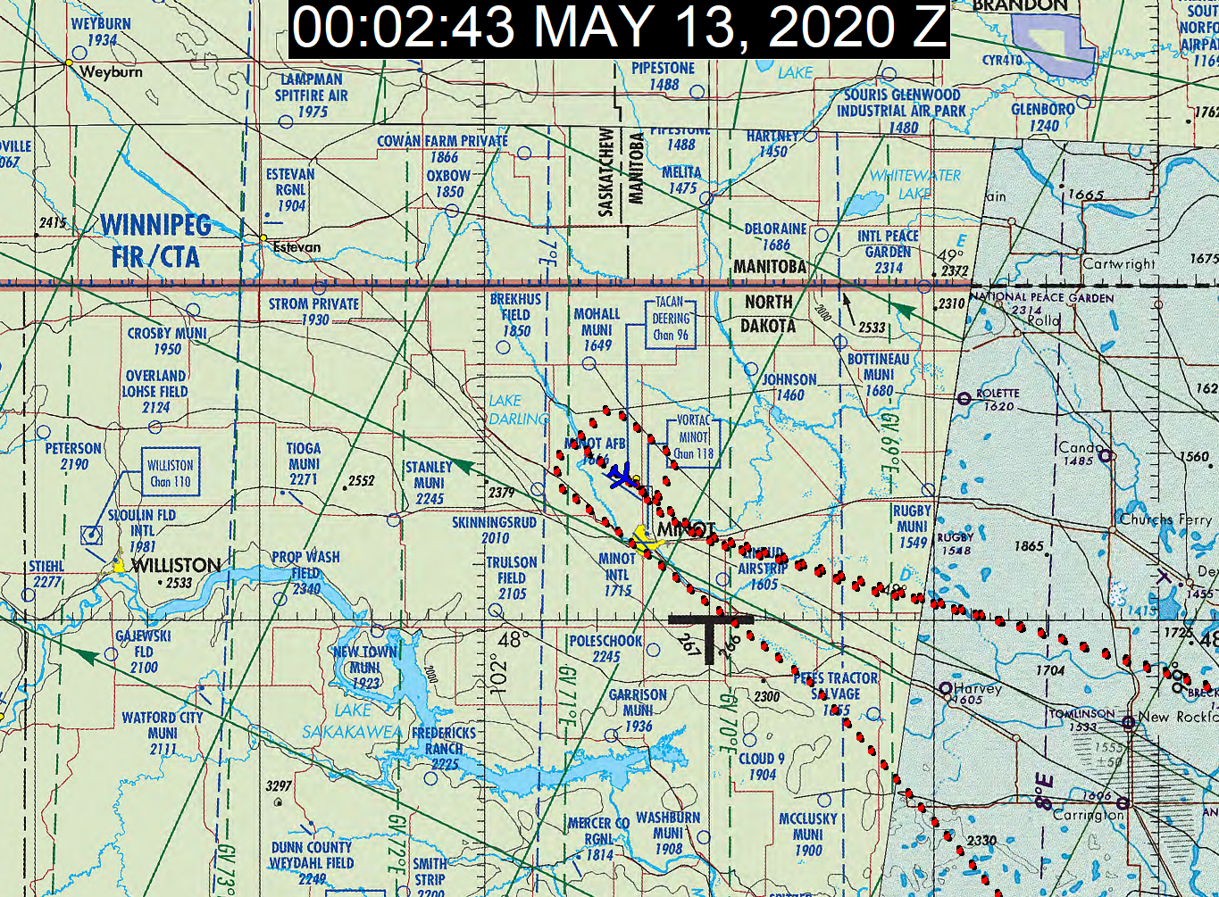
Step 4: Debrief Program GPS File
If JMPS is installed on the computer running the debrief program, it will automatically open up the GPS trail

Slide 19
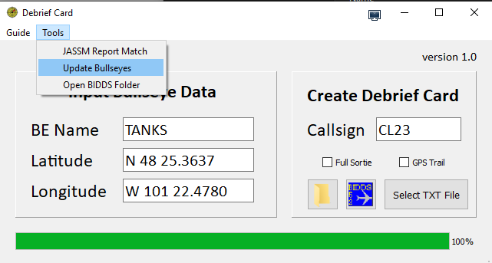
Optional Update Bullseye Data
Sometimes you may need to update bullseye data if the target coordinates to do not correctly pull from the DTC. To do so, update the coordinates on the Combined Tab and save, then click Tools>Update Bullseyes and select your debrief card
The bullseyes will be updated based on the Bullseye in the Debrief Card Program

Slide 20
Current Limitations
The DTC sometimes skips logging data
JASSM DT coordinates
GPS FOM not logged for every release
BIDDS does not output some records to the text file
Targeting Pod Data
ALCM releases
Some data is logged in unknown ways
JDAM delays are logged in integer/exponent that needs to be correlated to a ms delay. Therefore delays above 15 ms just show DELAY

Slide 21
Bug Reporting
If you find a bug or your data does not output to a card, save your text file for troubleshooting
Run the debrief card using debrief (debug).exe
Record what percent the progress bar got to
If any errors were displayed in the console window
What weapons released? Sim/War? OLS version

